Slide 1
Statutory Requirements
Design
Design
Installation &
Commissioning
Maintenance &
Repair
Modernisation
Replacement

Slide 2
Statutory Requirements
Design
Lifts Regulations 1997
The Supply of Machinery (Safety) Regulations 2008
Building Regulations (Scotland-Tech Handbook & England Part M)
Construction (Design and Management) Regulations 2007
BS 5655-6:2002 Code for the selection and installation of new lifts
BS 9999:2008 Code of practice for fire safety
BS ISO 4190 Lift Classifications
BS EN 81 Series of Standards - 1, 2, 28, 70, 71, 72, 73
BS EN 115-1:2008 +A1 2010 - Safety of escalators and moving walks - Construction and installation
Notes:
Highlight that hand-outs will be provided and this will list the relevant legislation and standards which are covered in the presentation

Slide 3
Statutory Requirements
Design
How do you know whether the lifts you own or manage are suitable for the buildings and the users that work or live there?
How many lifts are required? Who will use them? What will they be used for?
Notes:
Highlight that there is legal obligation to ensure that the lifts/escalators and buildings which we manage and operate need to be safe and fit for purpose. The type of user, building and environment may all impact on the safety of the equipment.

Slide 4
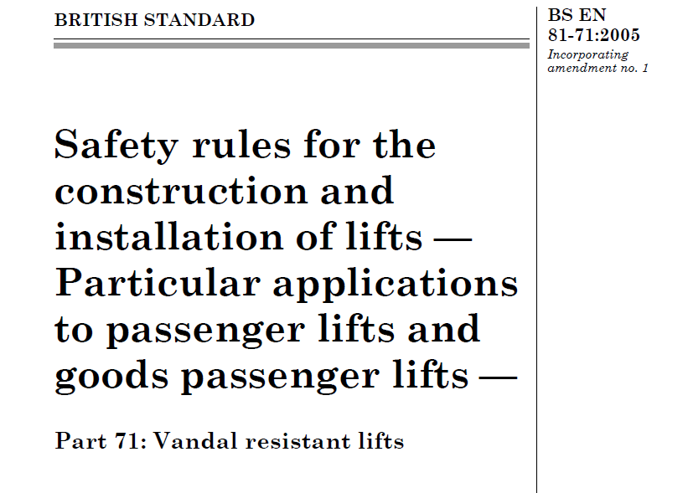
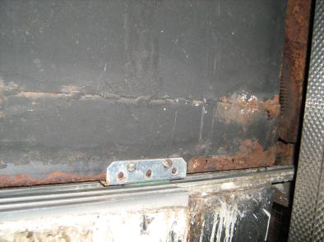
Statutory Requirements
Design
How does design and the law affect me?
Notes:
Highlight that designers, importers, manufacturers and suppliers all have a statutory obligation to ensure the safety of the equipment which they design or supply. Reasonably steps must be taken to understand how the equipment will be used and its intended application.

Slide 5
Statutory Requirements
Design
Legislation, EU & British Standards protect you against
Products which are not fit for purpose or the intended application
Lifts which pose a hazard to the users
Lift shafts and machinery spaces, which contain hazards
Unsafe working conditions for maintenance personnel
Inaccessible equipment which can’t be properly used or maintained
Lifts which are not accessible to all users
Inadequate fire safety and evacuation provision
Design according to Legislation, Standards and Best Practice and check that equipment will be suitable for the building, users and the intended application.
Notes:
Summary

Slide 6
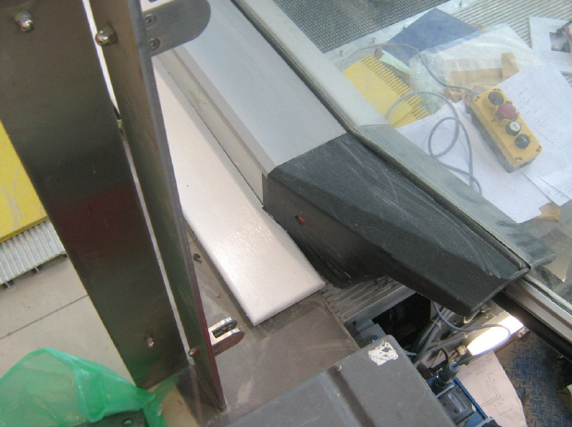
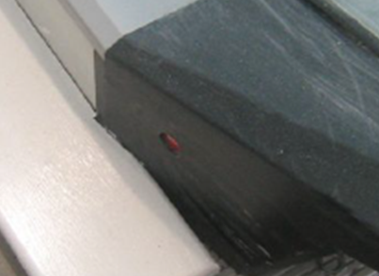
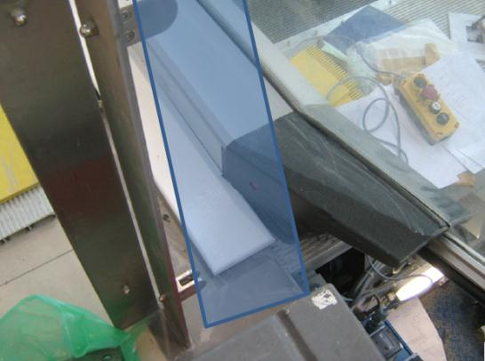
Statutory Requirements
Design
Legislation and standards can protect you against accidents which result from poor design co-ordination and a lack of knowledge of the user, building and application.
Glass infill
No access to stop button
Notes:
Highlight that design co-ordination and co-operation with others involved in the process can avoid unforeseen risks from arising at a later stage.

Slide 7
Statutory Requirements
Installation &
Commissioning
The Lifts Regulations 1997
The Supply of Machinery (Safety) Regulations 2008
Construction (Design and Management) Regulations 2007
The Management of Health and Safety at Work Regulations 1999
BS 8486: 2007 Examination & Test of New Lifts
BS 6440: 2011 Powered Vertical Lifting Platforms
BS EN 81 Series of Standards - 1, 2, 28, 70, 71, 72, 73.
BS EN 115-1:2008 +A1 2010 - Safety of escalators and moving walks - Construction and installation

Slide 8
Statutory Requirements
Installation &
Commissioning
OK…so now my lift has been designed properly how do I ensure it will be installed and commissioned properly?
Careful planning and co-ordination of the construction team
A clear understanding of the construction site risks and processes
Realistic programme timescales which allow sufficient time for the installation
Specified installation quality standards
Explicit testing and commissioning procedures
Final validation or witness testing by a competent person

Slide 9
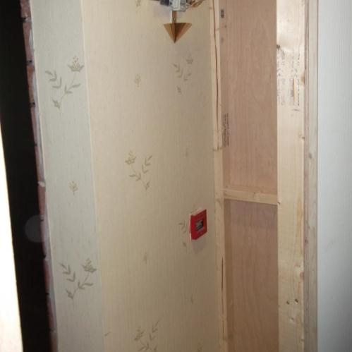
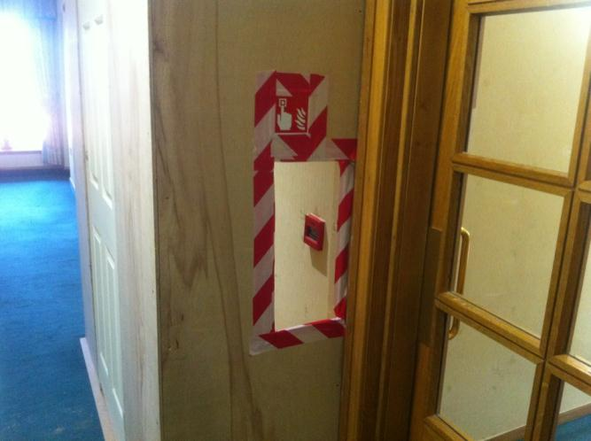
Statutory Requirements
Installation &
Commissioning
A clear understanding of the construction site risks and processes
Careful planning and co-ordination of the construction team
Hoarding preventing access to alarm
Fire Alarm
Notes:
Highlight that it is essential to understanding the risks associated with construction sites to allow effective co-ordination and to avoid simple hazards which could otherwise be avoided. MHSWR and CDM regs place and obligation on clients to ensure that correct procedures are in place to ensure the safety of employees and members of the public.

Slide 10
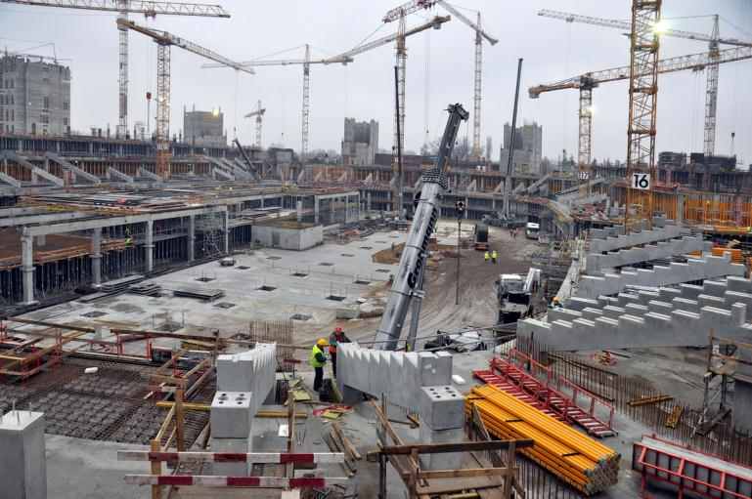
Statutory Requirements
Installation &
Commissioning
Realistic programme timescales which allow sufficient time for the installation
Opening tomorrow at 9am

Slide 11
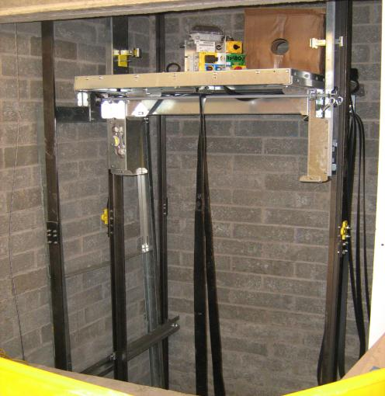
Statutory Requirements
Installation &
Commissioning
Well in that case here is your lift, all tested and ready to go
Notes:
Planning, organising, control and monitoring are fundamental requirements of any health and safety management system and each element requires the necessary resources to be effective. Highlight that there’s no point in setting unrealistic goals which are not achievable and pose additional risk to those responsible for delivering the end service or product and ultimately the user.

Slide 12
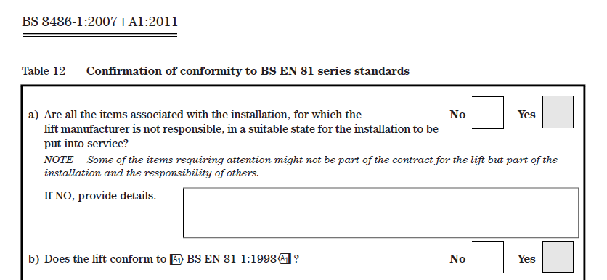
Statutory Requirements
Installation &
Commissioning
Explicit testing and commissioning procedures

Slide 13
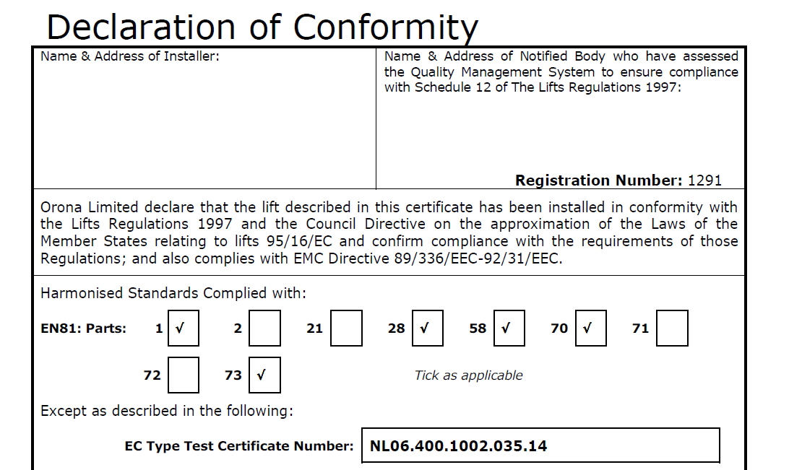
Statutory Requirements
Installation &
Commissioning
Final validation and certification to demonstrate legislative compliance

Slide 14
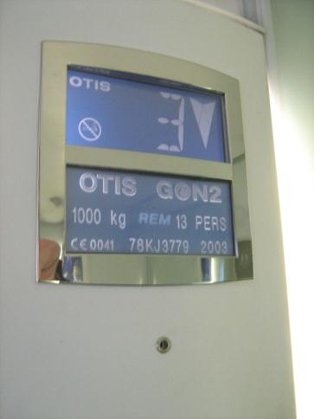
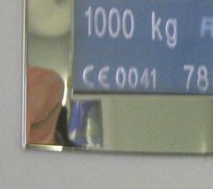
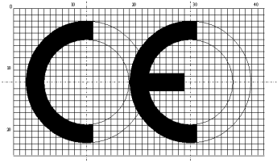
Statutory Requirements
Installation &
Commissioning
CE marks should be displayed once all the other testing and commissioning procedures have been completed and the lift complies fully with current legislation

Slide 15
Statutory Requirements
Installation &
Commissioning
OK…so now my lift has been designed properly how do I ensure it will be installed and commissioned properly?
Careful planning and co-ordination of the construction team
A clear understanding of the construction site risks and processes
Realistic programme timescales which allow sufficient time for the installation
Specified installation quality standards
Explicit testing and commissioning procedures
Final validation or witness testing by a competent person

Slide 16
Statutory Requirements
Maintenance &
Repair
The Management of Health and Safety at Work Regulations 1999
Lifting Operations and Lifting Equipment Regulations (LOLER) 1998
Provision of Use of Work Equipment Regulations (PUWER) 1998
The Control of Substances Hazardous to Health Regulations (COSHH) 2002
BS EN 13015 2001 - Maintenance for lifts and escalators - Rules for maintenance instructions
BS 7255 Code of practice for Safe Working on Lifts 2001
SAFed Guidelines on the supplementary tests of in-service lifts 2006

Slide 17
Statutory Requirements
Maintenance &
Repair
How can I be sure that maintenance work is being carried out properly and what certification do I need?
Valid and current insurance surveyors reports (LOLER)
Up to date maintenance reports and log card records
Maintenance procedures which reflect the specific needs of the lift/escalator
A process which ensures that recommendations from your insurer/contractor are given full consideration
Maintenance quality auditing processes and management procedures which ensure statutory and contractual compliance

Slide 18
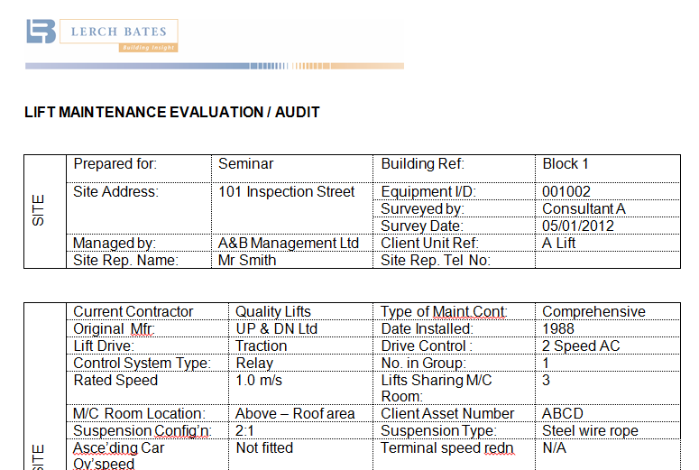
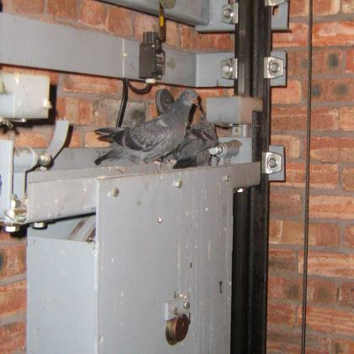
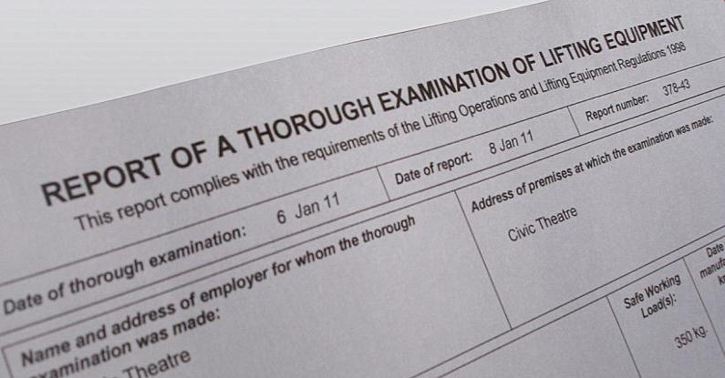
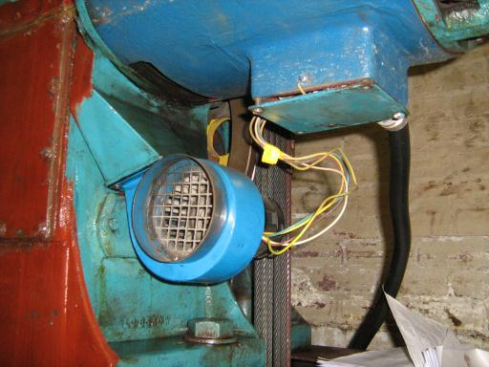
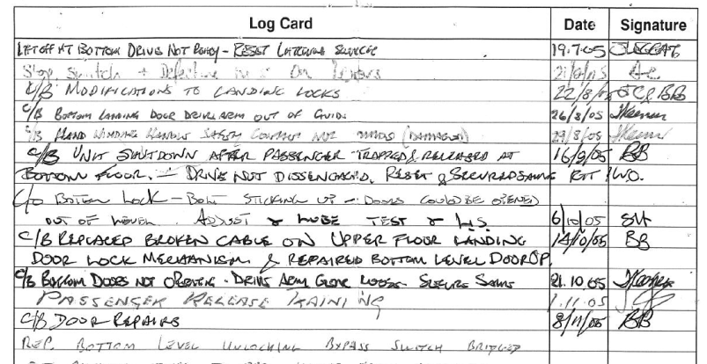
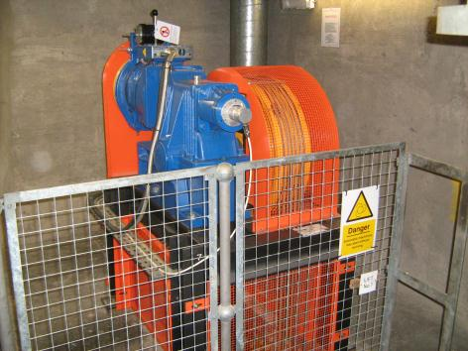
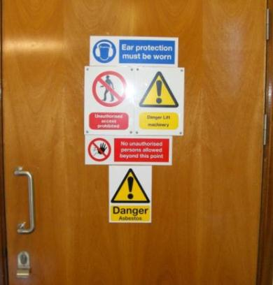
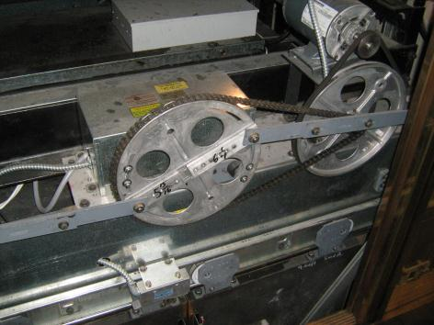
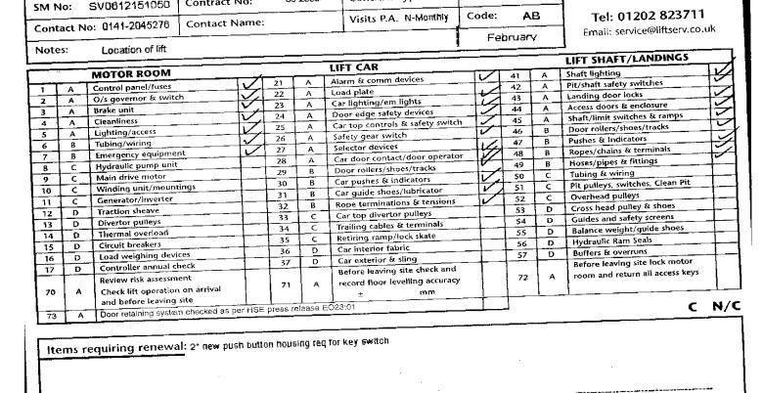
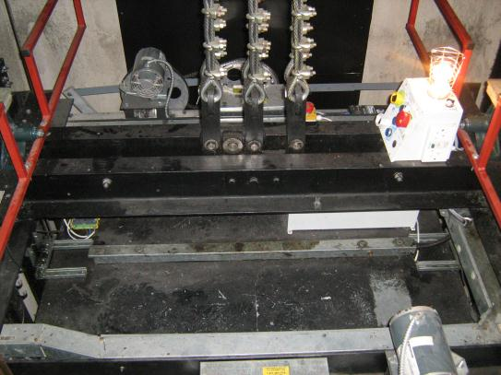
Statutory Requirements
Maintenance &
Repair
How can I be sure that maintenance work is being carried out properly and what certification do I need?

Slide 19
Statutory Requirements
Deign
Modernisation
BS 5655-11/12 2005 - Code of practice for the undertaking of modifications to existing electric/hydraulic lifts
BS EN 81-80 2003 Rules for the improvement of safety of existing passenger and goods passenger lifts
BS EN 115-2 - 2010 - Rules for the improvement of safety of existing escalators and moving walks
DD CEN TS 81-82 2008 Improvement of the accessibility of existing lifts for persons including persons with disability
DD CEN TS 81-83 2009 Rules for the improvement of the resistance against vandalism

Slide 20
Statutory Requirements
Deign
Modernisation
How do I prioritise what to do?
How do I ensure that any modernisation work does not compromise the safety of my lift/escalator?
When undertaking modifications to an existing lift/escalator the first consideration should be the retention of at least the existing level of safety. Under no circumstances should the installation be less safe after the modifications have been made.

Slide 21
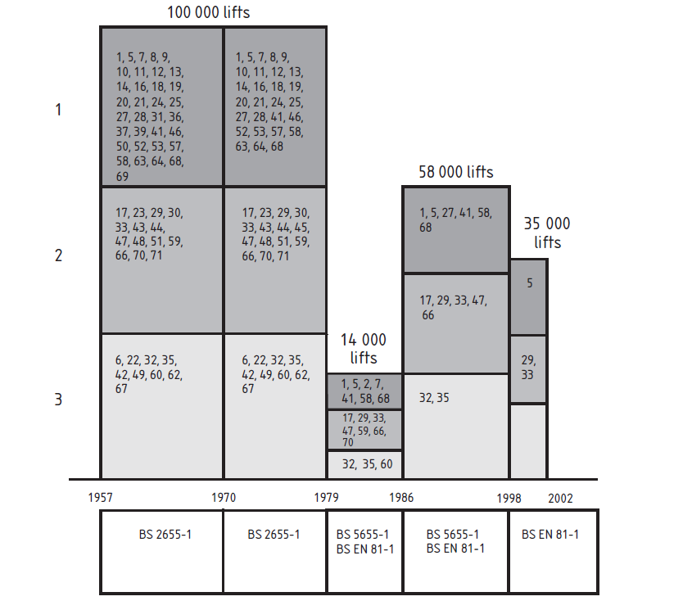
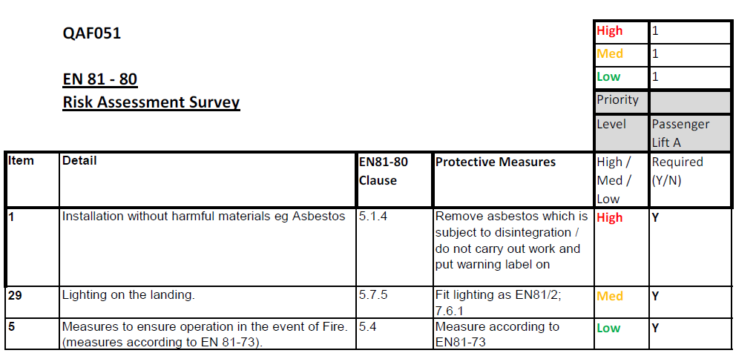
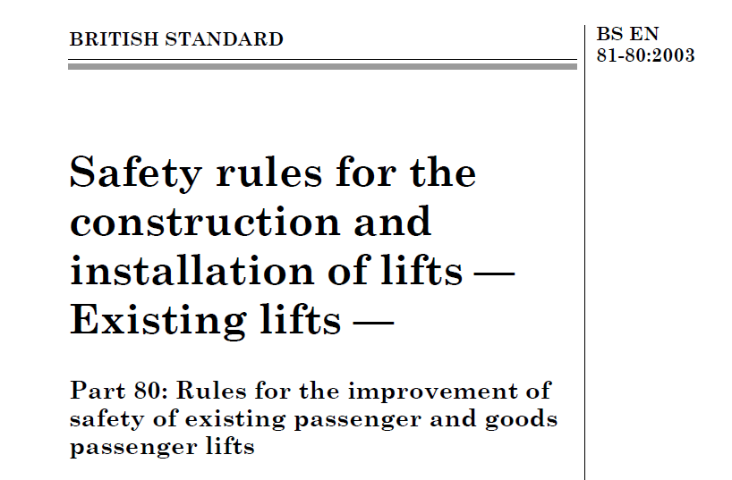
Statutory Requirements
Deign
Modernisation
How do I prioritise what to do?

Slide 22
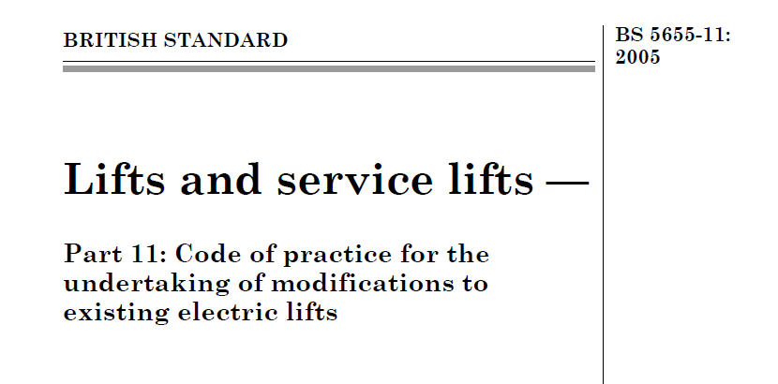
Statutory Requirements
Deign
Modernisation
How do I ensure that any modernisation work does not compromise the safety of my lift/escalator?

Slide 23
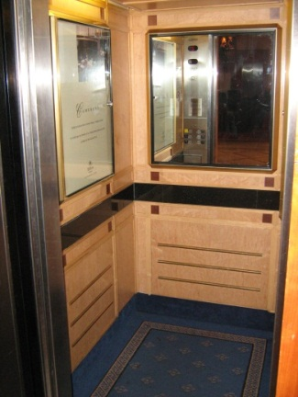
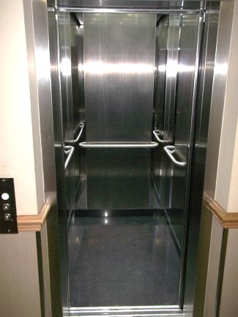
Statutory Requirements
Deign
Modernisation
Example – you decide to replace the lift car interior only.
Before
After
Steel wall panels
New ceiling
New lighting
Stone floor

Slide 24
Statutory Requirements
Deign
Modernisation
If all I have done is to replace the lift car interior fittings and fixtures do I still need to follow all of the above legislation/standards?
What are the consequences/risks associated with this modification?
Increased lift car mass/weight
Will the lift machine be able to lift the load and will the building support it?
Will the lift car frame be strong enough?
Will the ropes/suspension system still be sufficient?
Will the buffers, safety gear and guide rails still be suitable if all else fails?

Slide 25
Statutory Requirements
Deign
Modernisation
How do I prioritise what to do?
How do I ensure that any modernisation work does not compromise the safety of my lift/escalator?
BS EN 81-80 Risk Assessment
BS 5655-11/12 2005 - Code of practice for the undertaking of modifications to existing electric/hydraulic lifts
Ensure that the formulation or specification of any modernisation scheme is done in conjunction with a competent person with sufficient experience and knowledge to undertake a risk assessment to identify any issues which need to be addressed to ensure the safety of the modified installation.
Final testing and commissioning procedures to demonstrate compliance

Slide 26
Statutory Requirements
Replacement
BS EN 81-21 2009 New passenger and goods passenger lifts in existing building
BS EN 81 Series of Standards - 1, 2, 28, 70, 71, 72, 73.
BS EN 115-1:2008 +A1 2010 - Safety of escalators and moving walks - Construction and installation
Lifts Regulations 1997
The Supply of Machinery (Safety) Regulations 2008
Building Regulations (Scotland-Tech Handbook & England Part M)

Slide 27
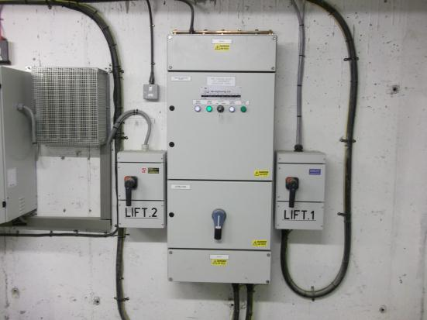
Statutory Requirements
Replacement
Is there anything else I need to consider over and above the lift?
Is the existing power supply sufficient?

Slide 28
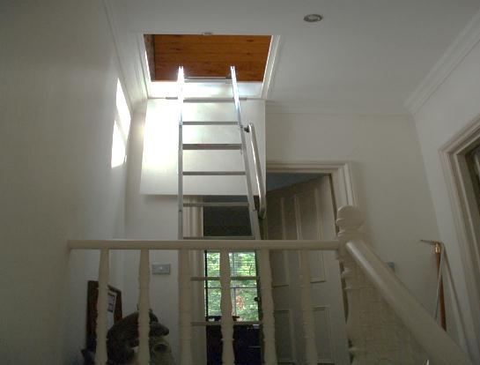
Statutory Requirements
Replacement
Is there anything else I need to consider over and above the lift?
Access to machinery spaces

Slide 29
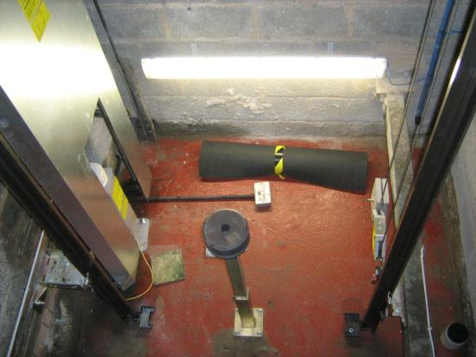
Statutory Requirements
Replacement
Is there anything else I need to consider over and above the lift?
Reduced pit depth and head room safety spaces

Slide 30
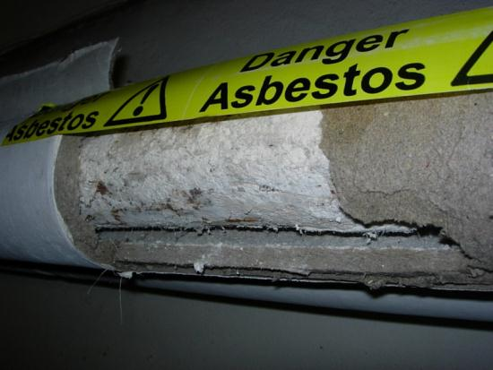
Statutory Requirements
Replacement
Is there anything else I need to consider over and above the lift?
Asbestos

Slide 31
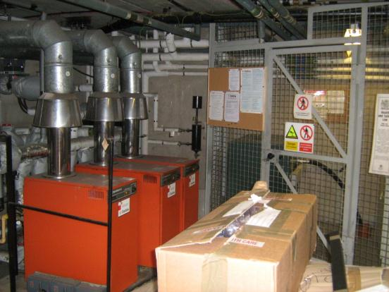
Statutory Requirements
Replacement
Is there anything else I need to consider over and above the lift?
Non lift services, water, gas, electricity, telecom etc.

Slide 32
Statutory Requirements
Replacement
When I’ve dealt with all the other issues how do I ensure that the new lift will comply with legislation and standards?
Commissioning procedures & tests
Declaration of conformity
CE Mark
Final validation by competent person
Remember by complying with legislation and following standards, guidance and best practice you are protecting the safety of yourself, your colleagues and members of the public.

